Slide 1
Amazon Sales Analysis Report
Dataset Name : Amazon Sales Report
Datasets: https://drive.google.com/file/d/1YrjYKtS1WHmINL6eafRsrDzrZaw2_WvX/view?usp=sharing
Problem Description:
The provided dataset contains information about sales transactions on Amazon, including details such as order ID, date, status, fulfilment method, sales channel, product category, size, quantity, amount, shipping details, and more. The objective is to conduct a comprehensive analysis of the data and extract actionable insights to support business decision-making.
Prepared by: Atharva MatheTools: Python, SQL, Tableau
Key Objectives :
Sales Overview: Understand the overall sales performance, trends, and patterns over time.
Product Analysis: Analyze the distribution of product categories, sizes, and quantities sold to identify popular products.
Fulfilment Analysis: Investigate the fulfillment methods used and their effectiveness in delivering orders.
Customer Segmentation: Segment customers based on their buying behaviour, location, and other relevant factors.
Geographical Analysis: Explore the geographical distribution of sales, focusing on states and cities.
Business Insights: Provide actionable insights and recommendations based on the analysis to optimize sales strategies, improve customer satisfaction, and enhance overall business performance.

Slide 2

PROJECT CONTEXT
Dataset Overview & Methodology
Dataset Overview & Methodology
Dataset Overview
The analysis is based on Amazon sales transaction data covering order-level details, time-based trends, product attributes, customer segmentation, fulfilment methods, and order outcomes.
Key variables include sales metrics (Amount, Quantity), product details (Category, Size), operational fields (Fulfilment, Ship-Service-Level, Courier Status, Fulfilled-By), and order status indicators (Delivered, Cancelled).
Geographical dimensions such as Ship-City, Ship-State, Ship-Postal-Code, and Ship-Country enable location-based performance and cancellation analysis.
Methodology
Python was used for data cleaning, preprocessing, and exploratory data analysis to identify trends and patterns.
SQL supported metric validation and structured aggregation for key KPIs.
An Interactive Tableau Dashboard was developed to visualise insights and support data-driven business decision-making.

Slide 3
Strategic Objectives
This project aims to transform raw transactional data into actionable business intelligence across five key analytical dimensions:
Sales Performance
Product Analysis
Fulfilment Efficiency
Comprehensive revenue analysis and temporal trend identification
Category performance and inventory optimisation insights
Logistics evaluation and cancellation pattern analysis
Customer Segmentation
Geographic Distribution
B2B versus B2C behavioural comparison
Regional revenue patterns and market opportunities

Slide 4
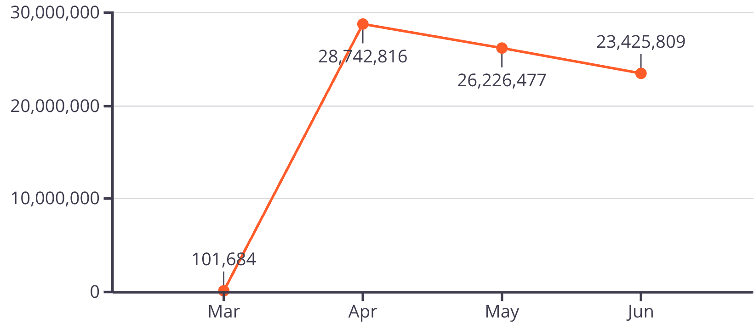
OBJECTIVE ONE
Sales Overview: Performance & Trends
₹78.46 Cr
1.28 Lakh
₹609.41
14.22%
Total Revenue
Total Orders
Average Order Value
Cancellation Rate
🔹 Insights
Revenue and order volume peaked in April, indicating a strong seasonal or campaign-driven performance.
Slight decline in May and June suggests post-peak normalization or reduced promotions.
A 14.22% cancellation rate is relatively high and represents a clear revenue leakage opportunity.
Monthly Sales Revenue

Slide 5
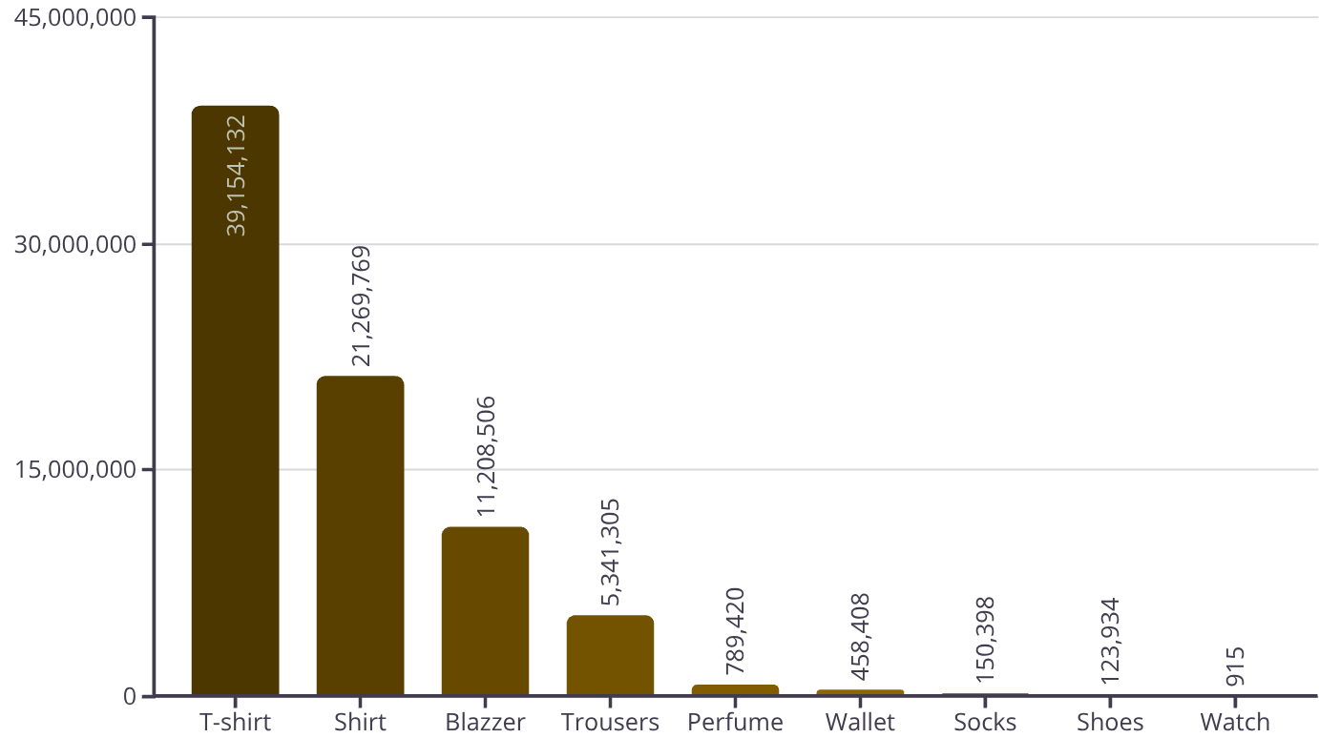
OBJECTIVE TWO
Product Analysis: Category Performance
🔹 Best Sellers
Best-Selling Product: T-shirt (45,228 units)
Highest Revenue Product: T-shirt – ₹39.15M
🔹 Category Contribution
Top 3 categories (T-shirt, Shirt, Blazer) generate ~90% of revenue
Long-tail categories (Wallet, Socks, Shoes, Watch) have minimal impact
🔹 Size Insights
Sales By Product
Most Popular Size: M
Sizes M, L, XL dominate across products
45,228
20,116
₹3.91 Cr
T-shirt
M - Size
T-shirt
Best-Selling Product Quantity
Most Popular Size
Best-Selling Product Revenue

Slide 6
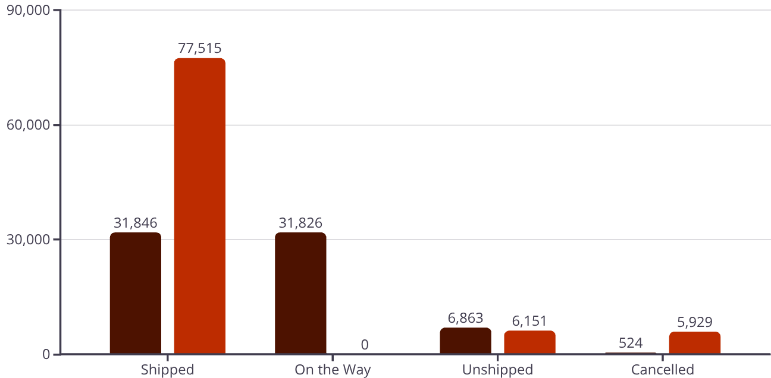
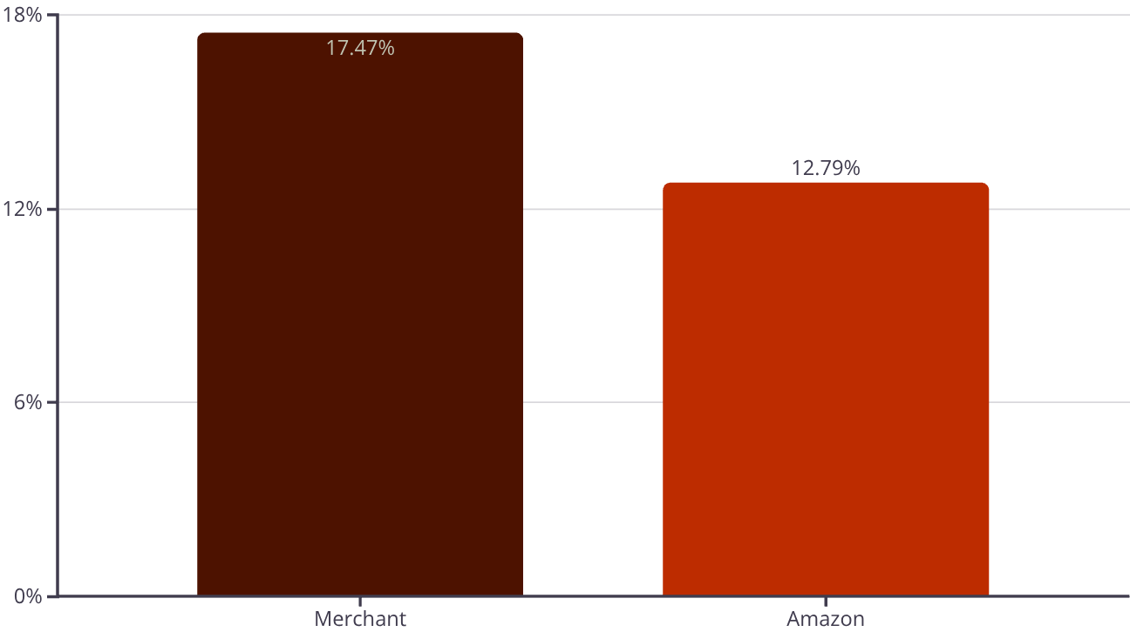
OBJECTIVE THREE
Fulfilment Analysis: Delivery & Logistics
Amazon Fulfilment
Market Share: 57.7% of total orders
Performance: Fastest delivery times with 17.47% cancellation rate
Customer Satisfaction: Highest ratings for reliability and tracking accuracy
Merchant Fulfilment
Market Share: 42.3% of total orders
Easy Ship
Not Easy Ship
Performance: Extended delivery windows with 12.79% cancellation rate
Courier Status Breakdown
Challenge Areas: Inconsistent courier performance and delayed shipments
Business Insight:
Despite Amazon’s faster delivery and higher reliability perception, cancellation rates remain significant across both fulfilment types, indicating scope for operational improvement.
Shifting more orders to Amazon fulfilment can reduce cancellations and improve CX.
Cancellation Rate By Fulfiment

Slide 7
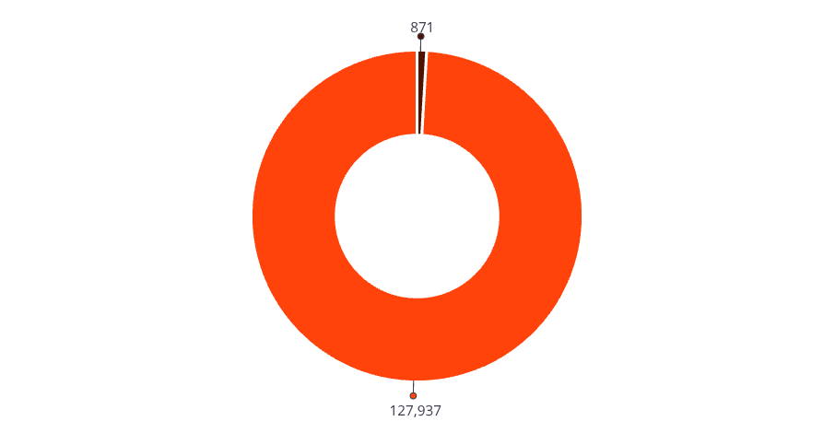
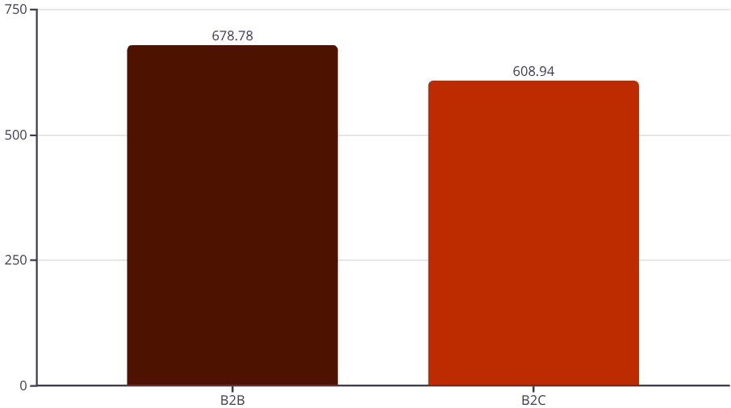
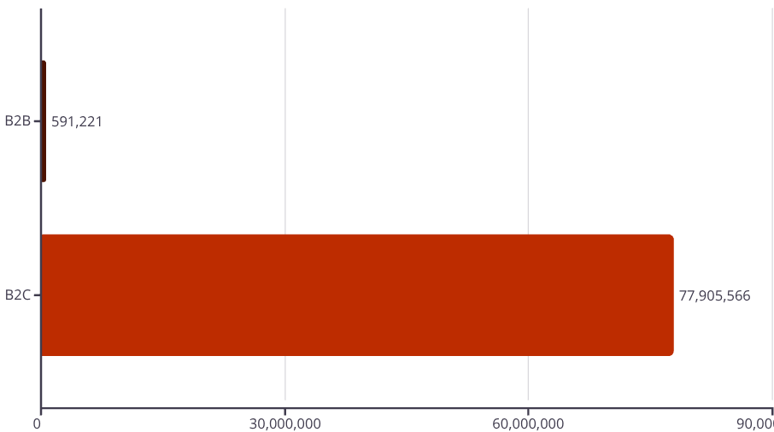
OBJECTIVE FOUR
Customer Segmentation: B2B vs B2C Insights
B2B
B2C
B2B Customer Behaviour
Very low order volume but high order value
B2C Customer Behaviour
Higher AOV (₹678.78) than B2C
~99% of total orders and main revenue driver
Low cancellation rate (8.54%)
Stable and predictable monthly demand
Lower AOV (₹608.94) compared to B2B
Orders By Segment
Strong growth opportunity with better profitability
Higher cancellations, causing revenue leakage
Seasonal spikes (peak in April)
High operational and logistics load
AOV By Segment
Business Insight:
B2B customers are higher quality, higher value, and more reliable.
There is a strong opportunity to scale B2B sales for stability and profitability.
Revenue By Segment

Slide 8
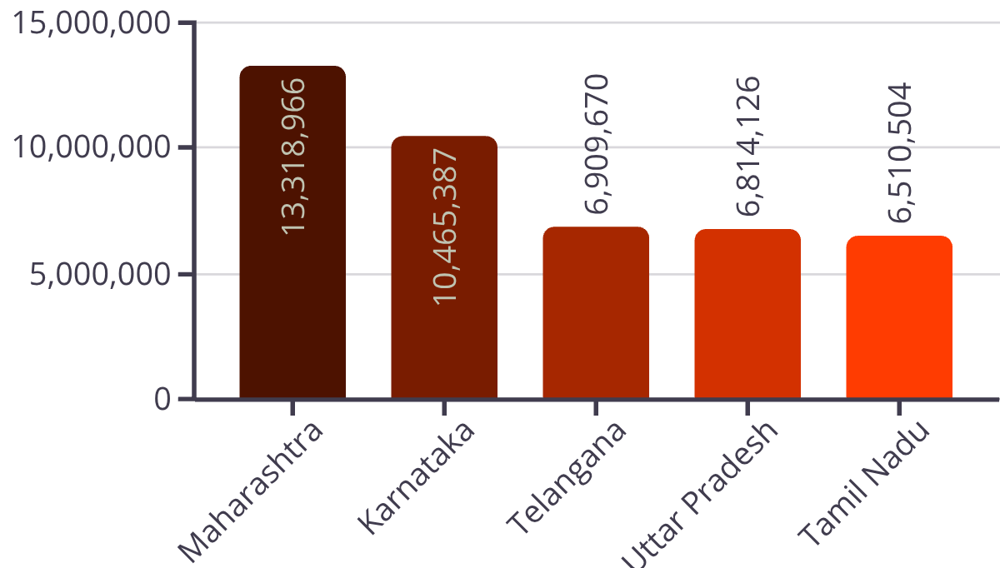
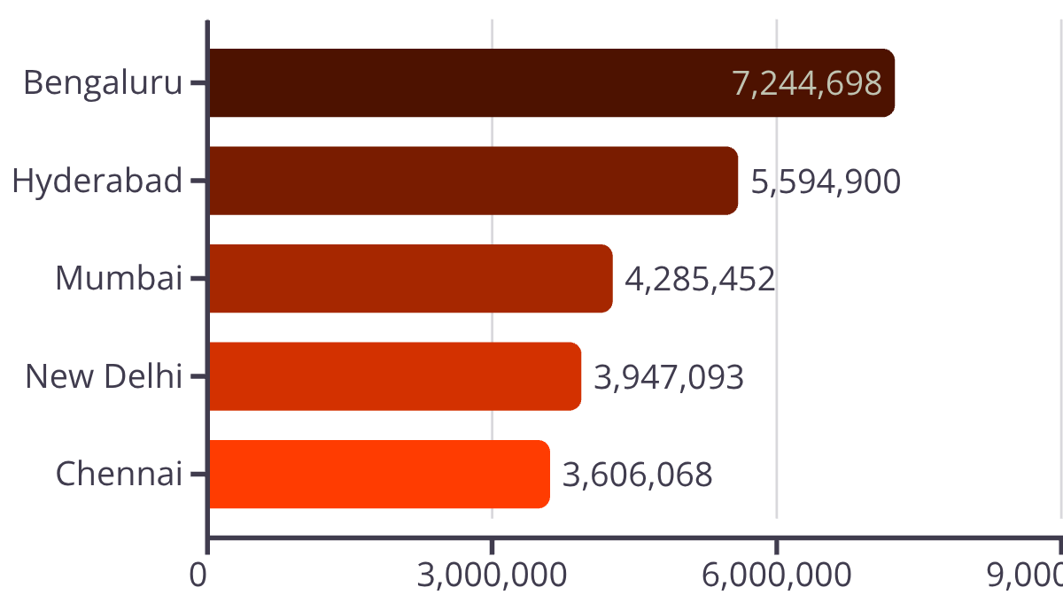
OBJECTIVE FIVE
Geographical Analysis: Regional Performance
State-Level Revenue Distribution
From the Geographical Analysis, it is clear that sales and revenue are highly concentrated in a few key states and metro regions. Maharashtra emerges as the top-performing state in terms of both order volume and revenue, with Bengaluru standing out as the highest revenue–generating city, highlighting the strong contribution of urban and economically developed regions. The top five states contribute 56.08% of total revenue, indicating a significant geographic dependency risk, as business performance is heavily reliant on limited regions. On the risk side, certain low-volume regions such as Lakshadweep show exceptionally high cancellation rates (25%), pointing to potential logistics, delivery reach, or customer experience challenges in remote locations. Overall, the dashboard suggests that while core states drive growth and stability, there is a clear need to diversify geographically and address high-cancellation regions to reduce risk and improve overall operational efficiency.
Top 5 States By Revenue
Top 5 Cities By Revenue

Slide 9





Strategic Business Recommendations
Based on comprehensive data analysis, we recommend the following strategic initiatives to enhance performance across key operational dimensions:
Reduce Cancellations by Optimizing Fulfilment & High-Risk Regions
Expand and Nurture the B2B Segment for Stable Growth
Focus on high-cancellation states (e.g., Lakshadweep and select North-East regions) and merchant-fulfilled orders, which show higher cancellation rates.
Although B2B contributes low volume, it has higher AOV and significantly lower cancellations.
Introduce bulk pricing, dedicated B2B SKUs, and account-based selling.
Increase Amazon-fulfilled coverage and improve last-mile logistics in remote regions.
Focus Inventory & Marketing on High-Performing Products and Sizes
Reduce Geographic Dependency Through Market Diversification
Apparel—especially T-shirts and Shirts—drives the majority of revenue, with M, L, and XL being the most popular sizes.
Over 56% of revenue comes from the top 5 states, increasing business risk.
Use targeted promotions and faster fulfilment options to grow Tier-2 and Tier-3 markets.
Reduce investment in low-performing categories (Wallets, Socks, Watches).
Implementation Priority:
Direct revenue recovery without increasing marketing spend.
Improves profitability, demand predictability, and reduces volatility.
Better inventory turnover, lower holding costs, and higher ROI.
More resilient revenue base and long-term scalability.

Slide 10
Conclusion & Key Takeaways
Overall, the analysis shows that the business is strongly driven by B2C demand in metro and top-tier states, with apparel—especially T-shirts—being the primary revenue contributor. While sales performance is healthy, high cancellation rates, geographic concentration, and underutilization of the B2B segment limit profitability and scalability. Addressing operational inefficiencies and rebalancing growth levers can significantly improve long-term performance.
B2C Drives Scale, B2B Drives Quality
Revenue Is Geographically Concentrated
B2C contributes most orders and revenue, while B2B offers higher AOV and lower cancellations, making it a strong growth opportunity.
Over half of the revenue comes from the top five states, increasing dependency risk and highlighting the need for regional diversification.
Cancellations Are a Major Revenue Leakage
Core Products and Sizes Power the Business
Higher cancellations in certain states and merchant fulfilment reduce net revenue and must be addressed operationally.
A small set of apparel products and popular sizes (M, L, XL) generate most revenue, enabling focused inventory and marketing strategies.
Implementation of these recommendations, supported by continued analytical monitoring, positions the business for sustained competitive advantage and accelerated revenue growth in an increasingly dynamic e-commerce landscape.

